Slide 1
Lipid Catabolism

Slide 2
Quiz Question #1
How does peroxisomal lipid oxidation differ from mitochondrial lipid oxidation?
Different terminal electron acceptor
Different rate limiting enzyme
Different substrate preferences
All of the above
Notes:
D

Slide 3
Quiz Question #2
What does not promote ketogenesis?
Lack of carbohydrates
Prolonged fasting
Reduced lipolysis in adipose tissue
Uncontrolled Type 1 Diabetes
Notes:
C

Slide 4
Quiz Question #3
Which tissue or organ is the most dependent on fatty acid oxidation for normal function?
White adipose tissue
Heart
Brain
Kidneys

Slide 5
Learning Objectives
Explain how triglyceride breakdown into glycerol and free fatty acids is controlled in adipocytes by hormonal signals.
Explain how high carbohydrate diets affect fuel utilization, including effects on lipid fuel utilization. Describe at an endocrine level how this is thought to occur.
Determine how much energy, in ATP equivalents, is released during the oxidation of a given fatty acid. Be able to relate the energy content of a fatty acid, in general to its physical properties (length and saturation).
Explain the rate limiting steps of lipid oxidation.
Explain how ketone bodies are converted to ATP in non-hepatic tissues, and what governs this specificity.
Demonstrate an understanding of how how de novo lipogenesis and b-oxidation are reciprocately controlled.
Describe how very long chain fatty acids are oxidized differently from long chain fatty acids.
Explain how odd-numbered fatty acids are catabolized, including the importance of vitamin B12 in this process.
Evaluate the role of transcriptional regulation and long term adaptations to fatty acid oxidative capacity.

Slide 6
Lipolysis

Slide 7
Why Triacylglycerol Breakdown
Stored as triglycerides, used as fatty acids
Brain and RBC can not utilize lipids as energy source
Hydrolysis of triacylglycerol yields: Glycerol and 3 fatty acids
Notes:
\

Slide 8
Regulation of Lipolysis
Promoted by
Glucocorticoids (transcriptional)
Adrenaline (protein phosphorylation)
Restricted by
Insulin (protein dephosphorylation)

Slide 9
Under What Conditions is DNL Occurring?
Control
High Glucose Overfeeding
High Sucrose Overfeeding
High Glucose, High Energy
Needs lots of Acetyl-CoA/NADPH/ATP
Contribution to overall lipid balance is due to sparing of fat when carbohydrates are present
DNL still very important for fatty liver disease
McDevitt RM, Bott SJ, Harding M, Coward WA, Bluck LJ, Prentice AM. De novo lipogenesis during controlled overfeeding with sucrose or glucose in lean and obese women. Am J Clin Nutr 2001; 74:737–46.

Slide 10
Dual Macronutrient Economy Hypothesis
Under Conditions of High Carbohydrates
Preferentially Use Carbohydrates as Fuel
Spares Fat
Prevents beta oxidation
Prevents lipolysis
Causes obesity?

Slide 11
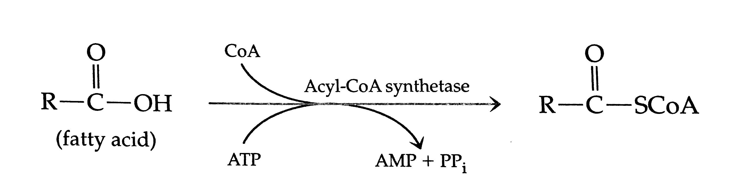
Fatty Acid Activation
Initial reaction converts fatty acid to fatty acid acyl-CoA (cytoplasm) (energy utilization – 2 ATP equivalents)
Fatty acid acyl CoA is transported from the cytoplasm to mitochondria for β-oxidation
Same as initial reaction for triglyceride synthesis

Slide 12
Fatty Acid Transport into Mitochondria
Carnitine transport system:
Uses carnitine as a carrier molecule
Carnitine moves fatty acyl CoA from cytoplasm across mitochondrial membrane to mitochondria

Slide 13
Where does carnitine come from?
Lysine
Arginine
Asparagine
Glutamine
Carnitine deficiencies
Genetically due to reduced transport into cells
1:67,000 individuals
Symptoms
Cardiomyopathy
Hypoketotic hypoglycemia
Why?
Notes:
Lysine

Slide 14
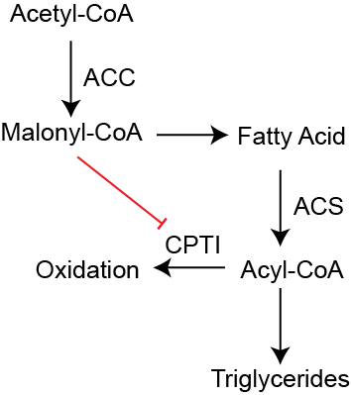
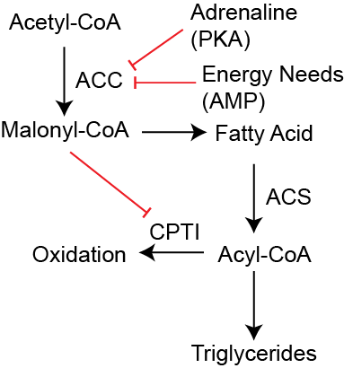
Co-ordinate regulation of lipogenesis and β-oxidation by ACC
The product of the ACC reaction inhibits CPTI
This prevents lipid oxidation while fatty acids are being made
Activated fatty acids (CoA-conjugated) are made into triglycerides
Adrenaline and energy needs inhibit ACC
This prevents Malonyl-CoA production
Activated fatty acids are oxidized

Slide 15
Chronic Regulation of Fatty Acid Oxidation
Peroxisome Proliferator Activating Receptor (PPARα and PPARδ)
Activated by several ligands (PUFAs, eiscosanoids, drugs)
Also increased by exercise (muscle) and increased fat uptake (liver and muscle)

Slide 16
Sequential β-oxidation
Starts at carboxyl end
Each cycle
Generates FADH2
Generates NADH
Generates Acetyl-CoA
Last step has two Acetyl-CoA as products
Notes:
38 per glucose
The 2 is from the activation to Acyl-CoA

Slide 17
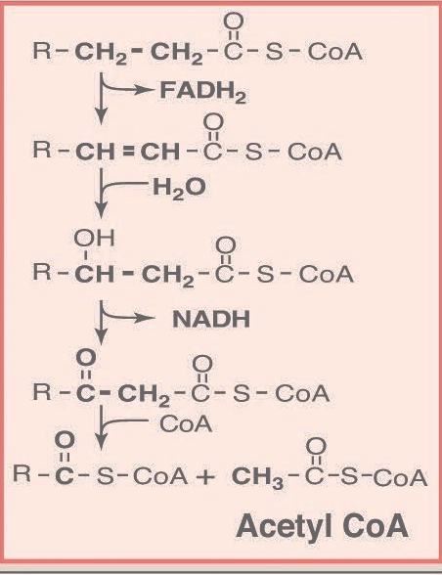
Unsaturated Fatty Acids and Chain Length
In general PUFA/MUFA are oxidized faster
Dehydrogenation step isnt needed
Short/medium chain fatty acids are also oxidized faster
Direct portal transport to liver
SCFA/MCFA do not need carnitine transport
Very long chain fatty acids oxidized in peroxisomes

Slide 18
Calculating Energy Content From Fatty Acids
Steps
Example (C16:1)
Length, subtract 2 and divide by two
Each cycle (14 ATP)
1 NADH (2.5 ATP)
1 FADH (1.5 ATP)
1 Acetyl-CoA (10 ATP)
Add back Acetyl-CoA from last step (10 ATP)
Remove 1.5 ATP per double bond
Remove 2 ATP for activation by ACS
(16-2)/2 = 7
14 x 7 leads to 98
1 leads to 10
1x1.5=1.5ATP -1.5
-2 ATP -2
104.5

Slide 19
Peroxisomal Beta Oxidation
Very long chain fatty acids (>22 C) are selectively oxidized in peroxisomes
Not coupled to ETC
Peroxide generated instead of O2 -> H20
Peroxide removed as catalase (no ATP generated here)
SCFA and MCFA sent to mitochondria
Defects lead to accumulation of VLCFA (Zellweger syndrome)

Slide 20
Learning Objectives
Explain how triglyceride breakdown into glycerol and free fatty acids is controlled in adipocytes by hormonal signals.
Explain how high carbohydrate diets affect fuel utilization, including effects on lipid fuel utilization. Describe at an endocrine level how this is thought to occur.
Determine how much energy, in ATP equivalents, is released during the oxidation of a given fatty acid. Be able to relate the energy content of a fatty acid, in general to its physical properties (length and saturation).
Explain the rate limiting steps of lipid oxidation.
Explain how ketone bodies are converted to ATP in non-hepatic tissues, and what governs this specificity.
Demonstrate an understanding of how how de novo lipogenesis and b-oxidation are reciprocately controlled.
Describe how very long chain fatty acids are oxidized differently from long chain fatty acids.
Explain how odd-numbered fatty acids are catabolized, including the importance of vitamin B12 in this process.
Evaluate the role of transcriptional regulation and long term adaptations to fatty acid oxidative capacity.

